Slide 1
Using Bayesian Optimization in Pose Graphs Based SLAM 16th June
Zuxun Wang

Slide 2
Progress Since Last Meeting
Read the paper
focusing on the Consistency Measurement metric, checking if the graph is tuned correctly.
Using MATLAB template code, computing the new metric C introduced in the paper using linear model.
Generate the 2d-depth graph (similar to Fig. 3. in the paper)

Slide 3
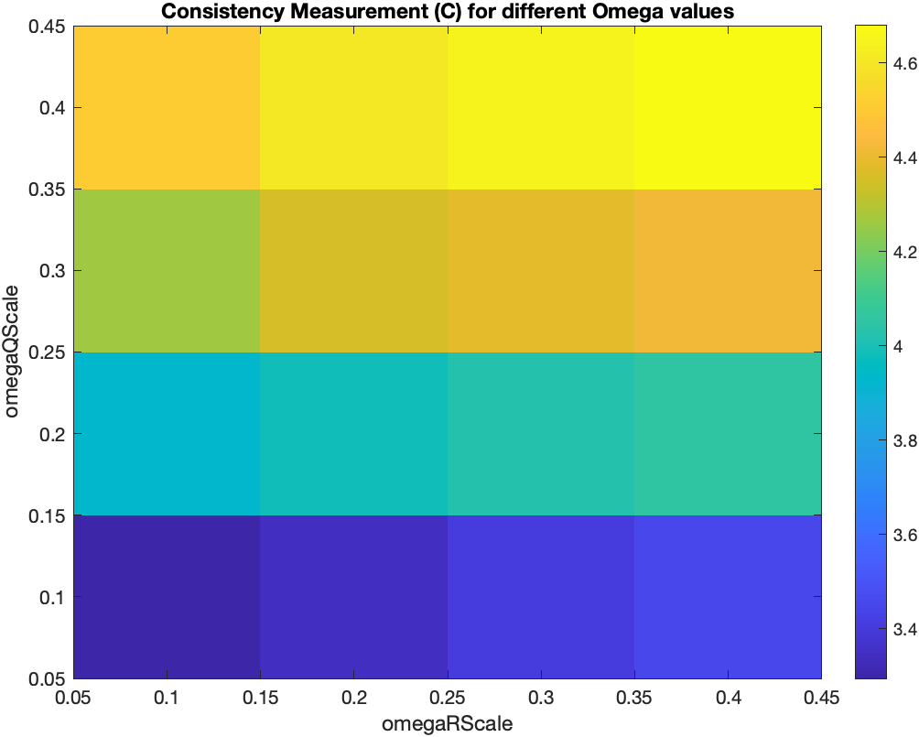
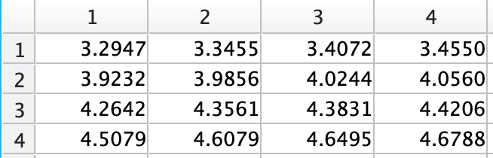
OmegaScale from 0.1 to 0.4 with stride 0.1
C_store

Slide 4
Show Code using MATLAB

Slide 5
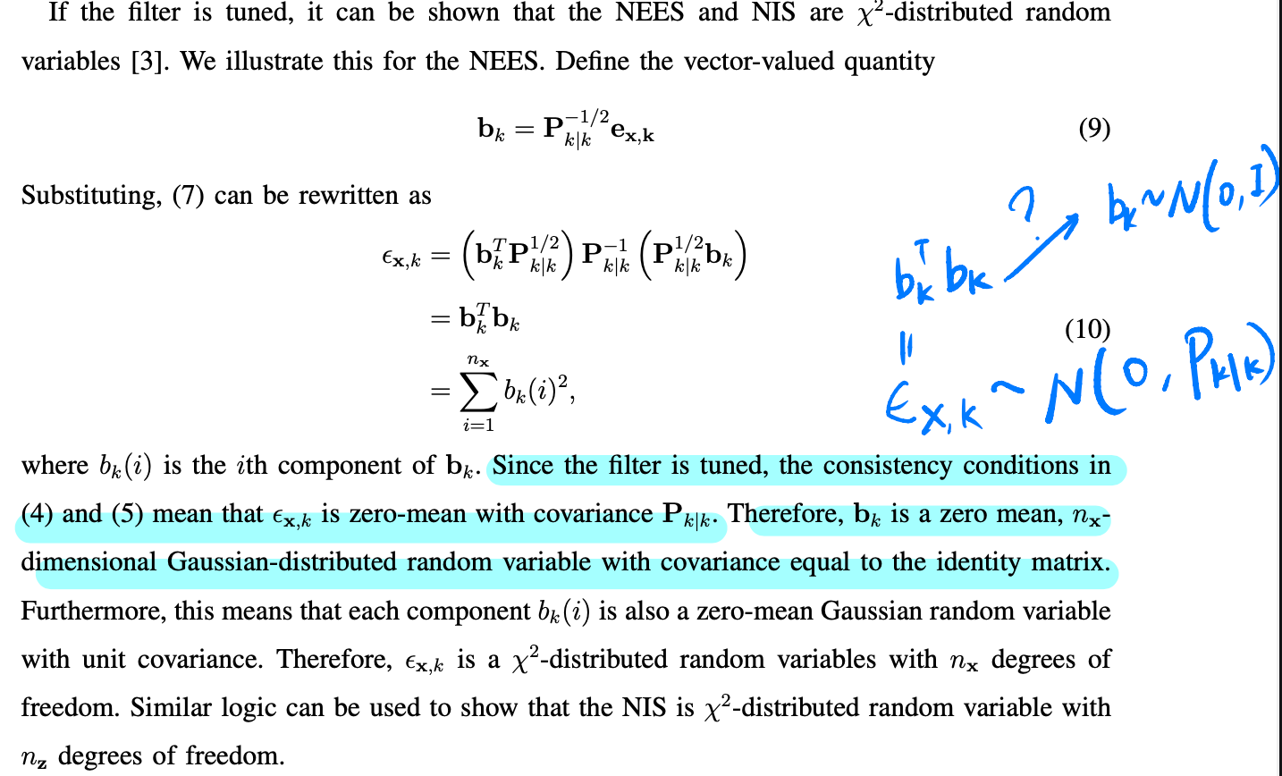
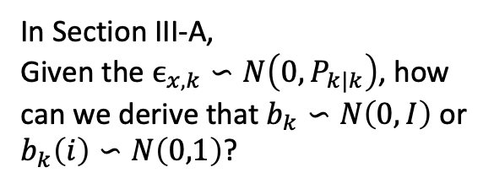
Problems / Issues
In Section III-A,
Given the $ϵ_{x,k}∽N\left(0,P_{k|k}\right)$, how can we derive that $b_{k}∽N\left(0,I\right)$ or $b_{k}\left(i\right)∽N\left(0,1\right)$?

Slide 6
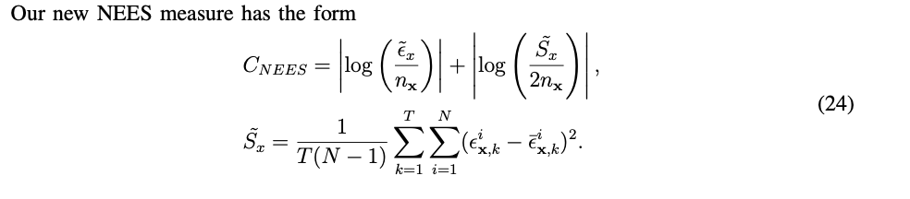
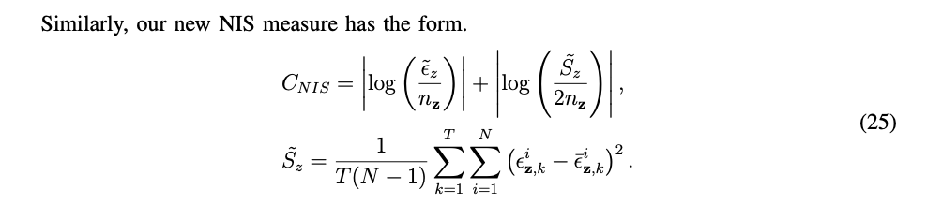

Problems / Issues
In Section V-D, new Consistency Measures were introduced.
In the code, instead of splitting out process and observation model edges, I treated them as the same to compute $\left(\tilde{S}={\tilde{S}}_{x}+{\tilde{S}}_{z}\right)$.
Is it correct? (It seems to be a bad practice)
or should I compute ${\tilde{S}}_{x}$ and ${\tilde{S}}_{z}$ respectively?

Slide 7
Planned Activities
Modify code to compute dim (Parfor) Omega: 1.0 -> 1.9
[Report] Introduction

